Slide 1
Coding standards

Slide 2


Slide 3
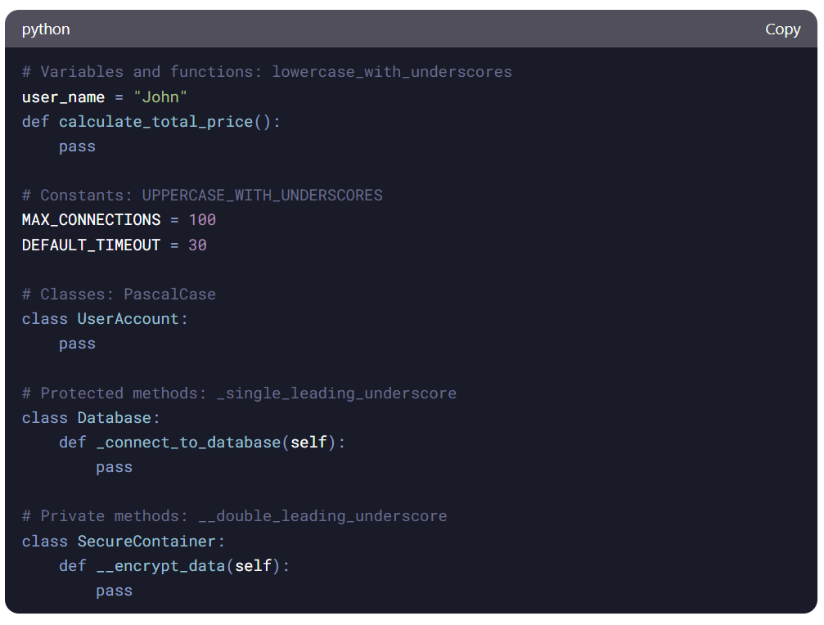
Python - Naming Conventions

Slide 4
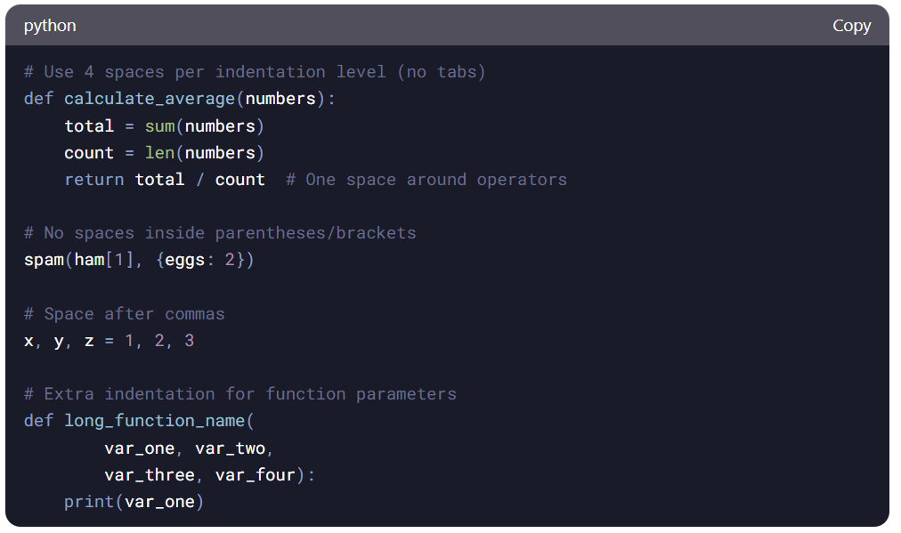
Python - Indentation and Whitespace

Slide 5
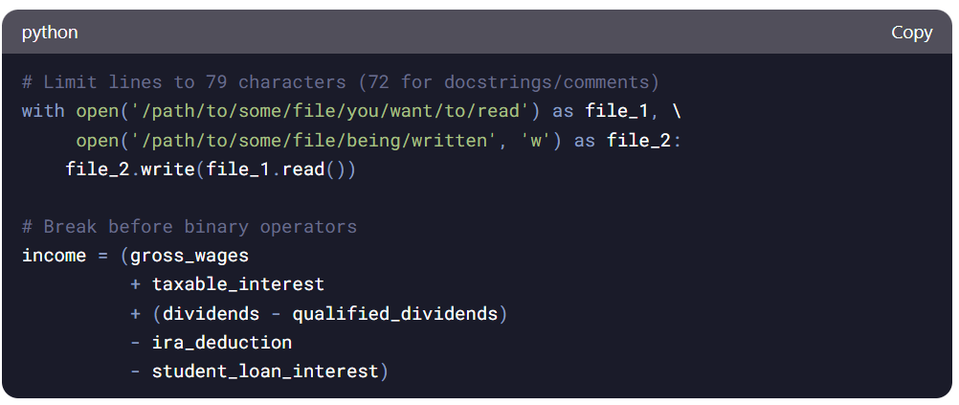
Python - Line Length and Breaking

Slide 6
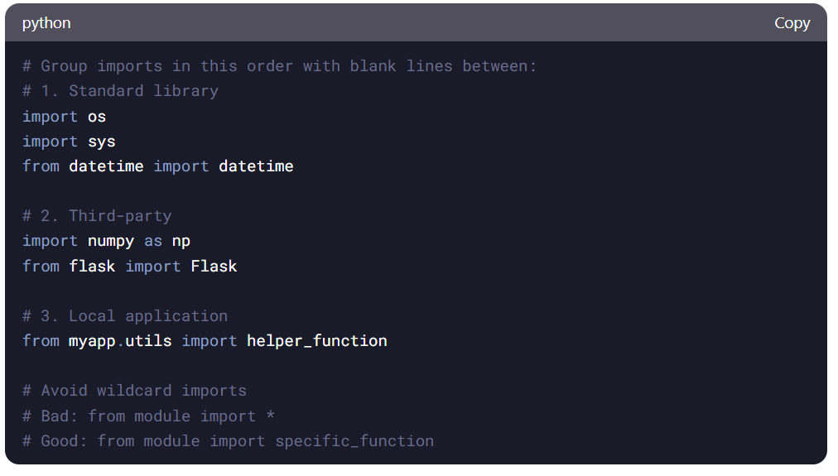
Python - Imports

Slide 7
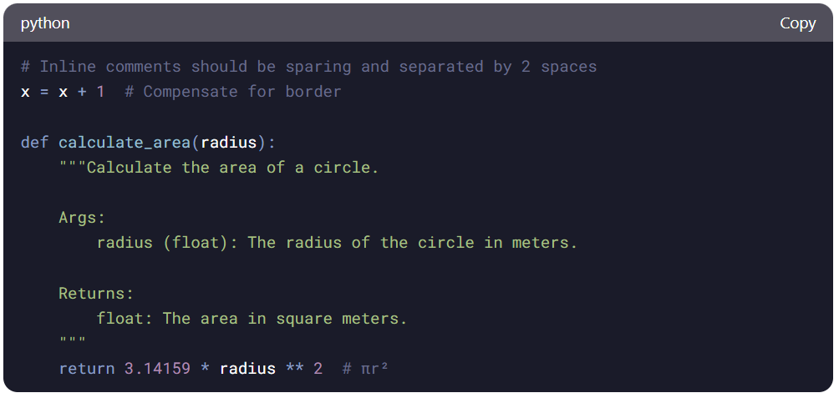
Python - Comments and Docstrings

Slide 8
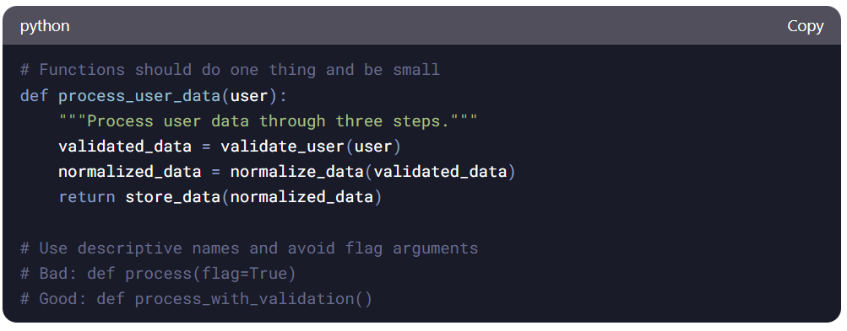
Python - Function and Method Design

Slide 9
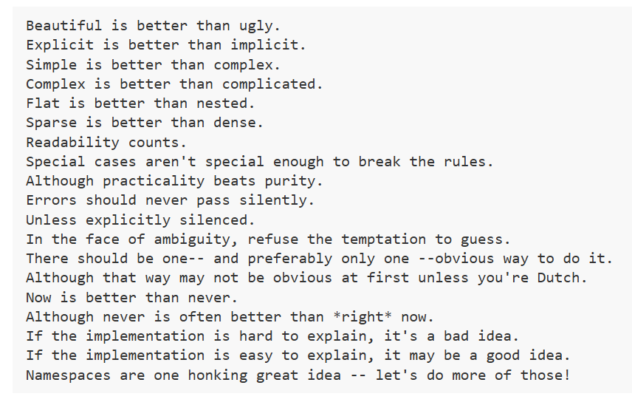
Python – Zen of Python

Slide 10
The best coding practice standard for Python is PEP 8. For more structure Google standard is a good one but pretty stuffy

Slide 11


Slide 12
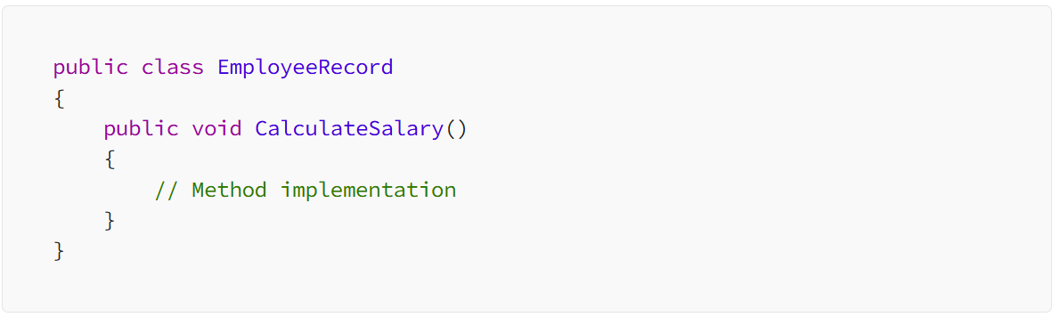
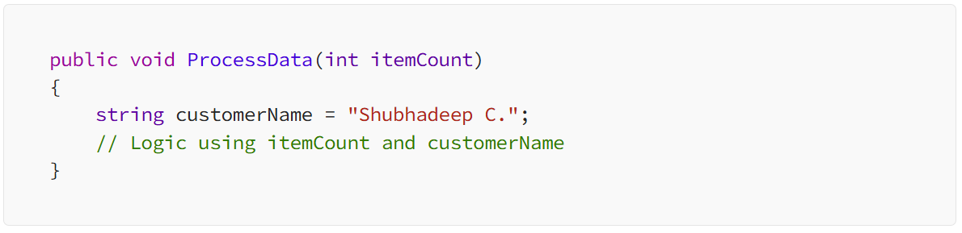
C# - Classes and Methods, Variables and Parameters
Notes:
Use PascalCase for class, method, property, and event names (e.g., MyClass, MyMethod, MyProperty).
Use camelCase for local variables and parameters (e.g., myVariable, myParameter).
Use uppercase for constant names (e.g., MY_CONSTANT).
Prefix interfaces with ‘I’ (e.g., IMyInterface).

Slide 13
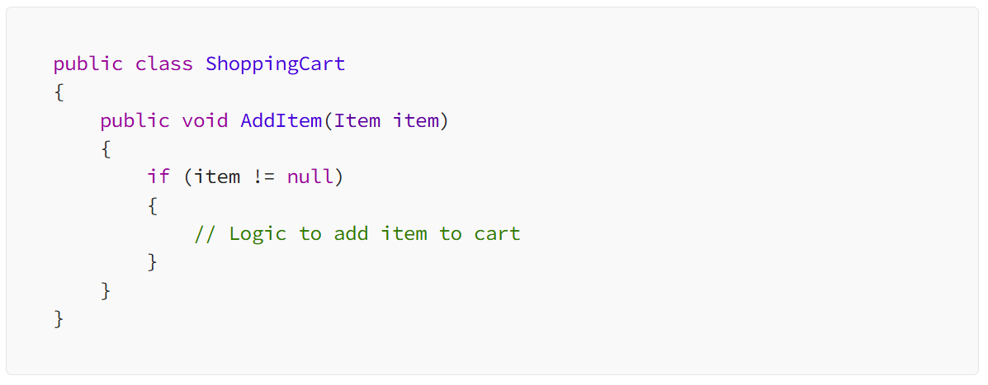
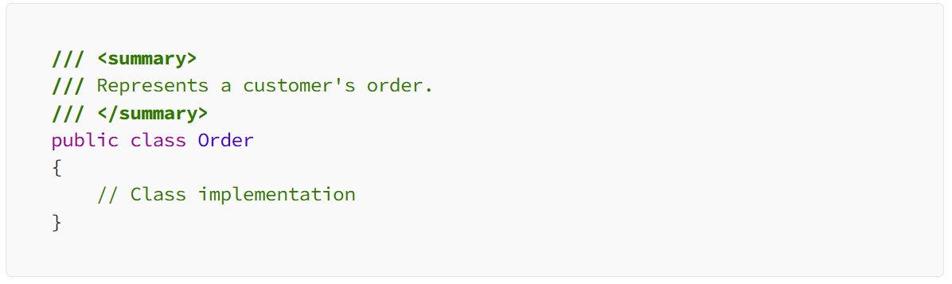
C# - Indentation and Braces; Enlightening Documentation
Using a consistent indentation keeps the codebase organized
Well-documented code is a treasure trove of insights for fellow developers
Notes:
Use XML comments to document classes, methods, and properties.
Include a summary, remarks, and example sections in your XML comments.
Use single-line comments (//) for brief explanations within the code.
Avoid excessive comments; aim for self-explanatory code.

Slide 14
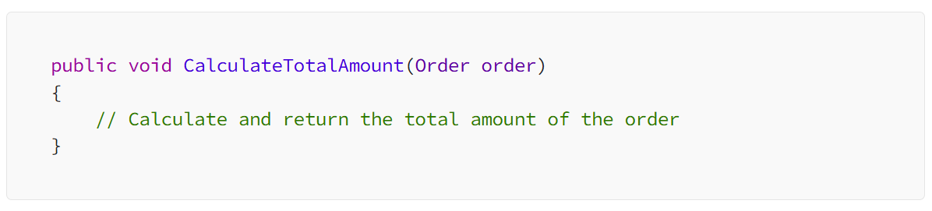
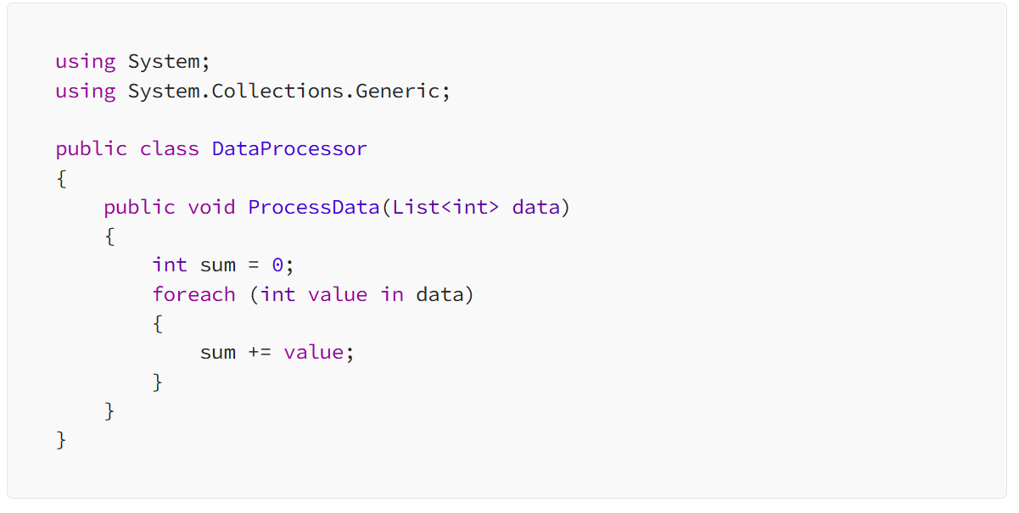
C# - Self-Explanatory Code, Formatting and Style
Notes:
Use spaces around operators (e.g., x = y + z instead of x=y+z).
Leave a space after commas in parameter and argument lists.
Use blank lines to separate logical sections of code.
Prefer string interpolation ($"Hello, {name}") over concatenation.
Use string.Format or interpolated strings for formatting.

Slide 15
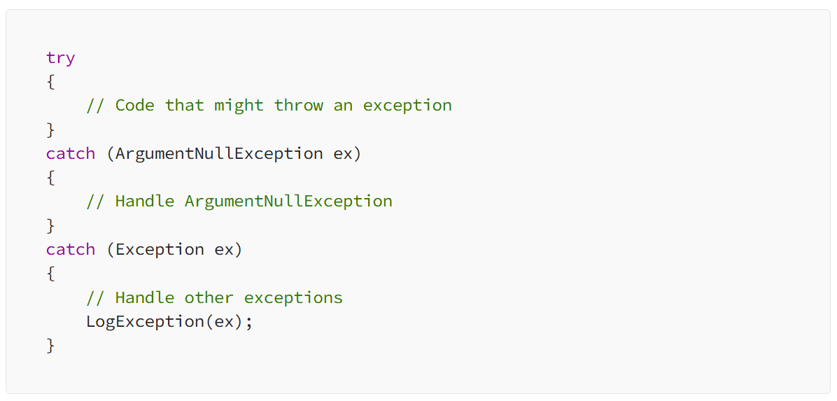
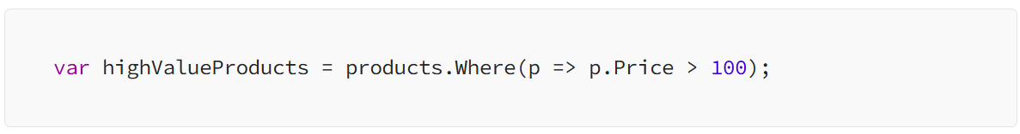
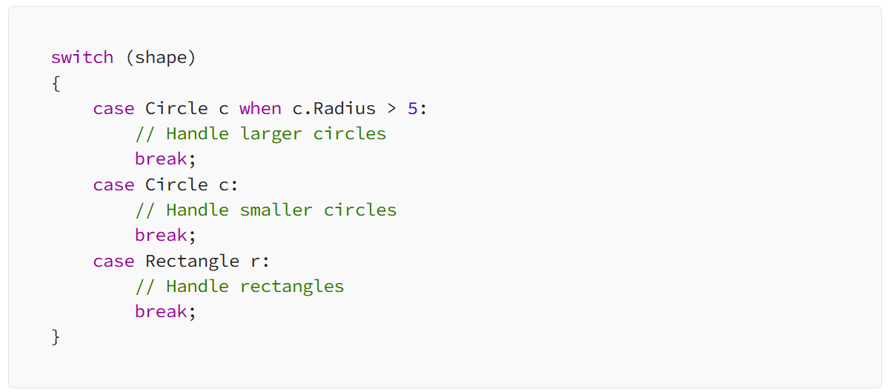
C# - Error Handling, Mastering Advanced Techniques
Avoid catching generic exceptions unless necessary; catch specific exceptions instead.
Log or handle exceptions appropriately based on their severity.
Lambdas
Lambdas
Implicit casting

Slide 16
A great example for C# coding standard HERE

